Slide 1


Access Your Required Course Materials
Connect® Course Resources for GENG 8000

Slide 2

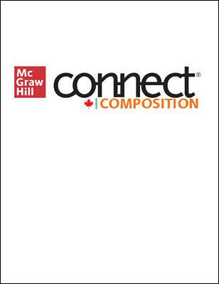
About Your Course
Course Name | GENG 8000
Course Code | GENG 8000
Resource | Connect Composition 5e
Resource Author | McGraw et al
Course URL | https://connect.mheducation.com/class/j-ziter-geng-8000---section-004---winter-2023
Need help logging in?
Click here to speak with our
Digital Technical Support team
McGraw Hill | Making the Most of Your Course Tools
2

Slide 3

Why Connect?
Connect is your personalized digital learning platform that makes studying and getting work done easier and more convenient than ever.
Maximize your study time
with a personalized learning path.
Save time – access
assignments & learning tools in one place.
Achieve better grades & track your progress.
Learn online or offline, anytime, anywhere.
McGraw Hill | Making the Most of Your Course Tools
3

Slide 4

Purchase Options
Connect Online Access
McGraw Hill offers a variety of purchase options so you can choose the flexible course materials that suit your learning style.
Connect Online Access
Available through course URL
or through
Windsor Bookstore
Receive instant access to:
eBook, homework and adaptive assignments, and study resources
Personalize your learning, save time completing homework, and maximize your course grade
Download the free ReadAnywhere App for offline access to eBook and resources
Available through course URL
or through
Windsor Bookstore
Receive instant access to:
eBook, homework and adaptive assignments, and study resources
Personalize your learning, save time completing homework, and maximize your course grade
Download the free ReadAnywhere App for offline access to eBook and resources
McGraw Hill | Making the Most of Your Course Tools
4

Slide 5

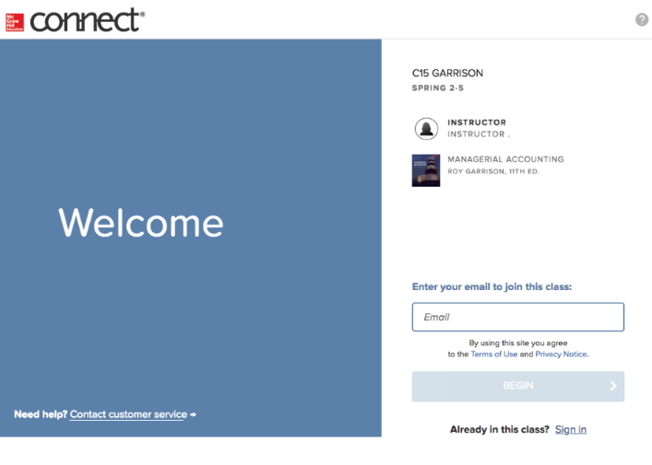
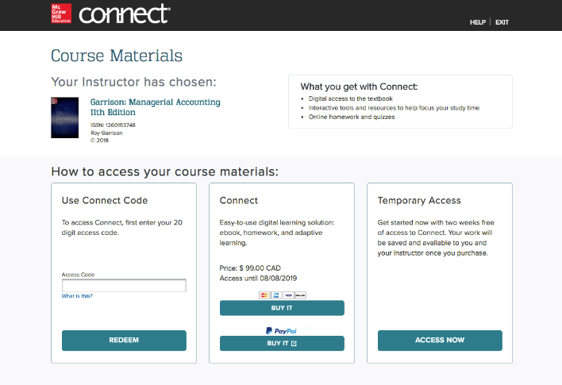
How To Register
After you have purchased Connect from your bookstore or through the Connect Course URL follow the steps below:
STEP 1
Enter your institution email and sign in or register for a new account.
STEP 2
Enter your 20-digit Connect access code you have pre-purchased.
STEP 3
If you have not already purchased a Connect access code, you can choose [Buy It] for immediate full access.
Click here for a quick registration tutorial
McGraw Hill | Making the Most of Your Course Tools
5

Slide 6

Studying Abroad?
New to Connect
STEP 1: Purchase Connect
Purchase via your instructor’s Connect course URL, or visit your Canadian institution’s bookstore website, search for your course, and choose the Connect online access purchase option.
STEP 2: Verify Your Institution
While you create your McGraw Hill account, be sure that your Connect profile institution name and mailing address is the same as your Canadian institution’s name and mailing address.
Existing Connect Account
STEP 1: Verify Your Institution
Ensure that your Connect profile institution name and mailing address is the same as your Canadian institution’s name and mailing address.
STEP 2: Purchase Connect
If you are studying abroad, purchase Connect online access via your instructor’s Connect course URL or visit your Canadian institution’s bookstore website, search for your course, and choose the Connect online access purchase option.
Need Support? https://mhedu.force.com/CXG/s/ContactUs
McGraw Hill | Making the Most of Your Course Tools
6

Slide 7


Best Practices
Connect Best Practices
Use Google Chrome as your internet browser
Clear your browser cache prior to the start of an assignment, simulation, quiz or exam.
Complete a Computer Compatibility Check.
Complete the assignment, simulation, quiz or exam on your laptop or desktop rather than a mobile device.
Reminders
Connect should be loaded on ONE session of your browser and only ONE tab within your browser.
Use an ethernet cable to directly connect your device to your internet modem for faster speeds.
Limit the number of applications running and devices connected to your wireless internet while completing your assignment.
McGraw Hill | Making the Most of Your Course Tools
7

Slide 8

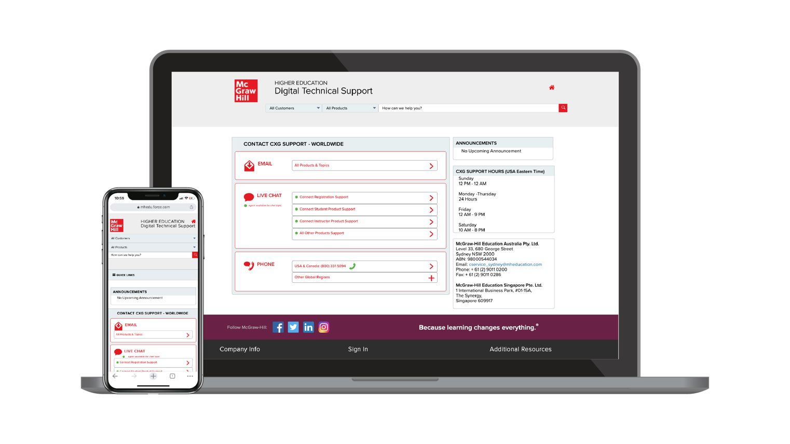
Accessibility & Support
Support Hours (ET)
Sunday
12 PM – 12 AM
Monday - Thursday
24 Hours
Friday
12 AM – 9 PM
Saturday
10 AM – 8 PM
Accessibility
If you have any questions or concerns about interacting with our products, please contact your institution's Accessibility Office.
Support
We’re here to help. If you need technical help with Connect, get in touch with our experts:
Phone: (800) 331 5094 (USA & Canada)
Web: https://mhedu.force.com/CXG/s/ContactUs
McGraw Hill | Access Your Required Course Tools
8

